Slide 1
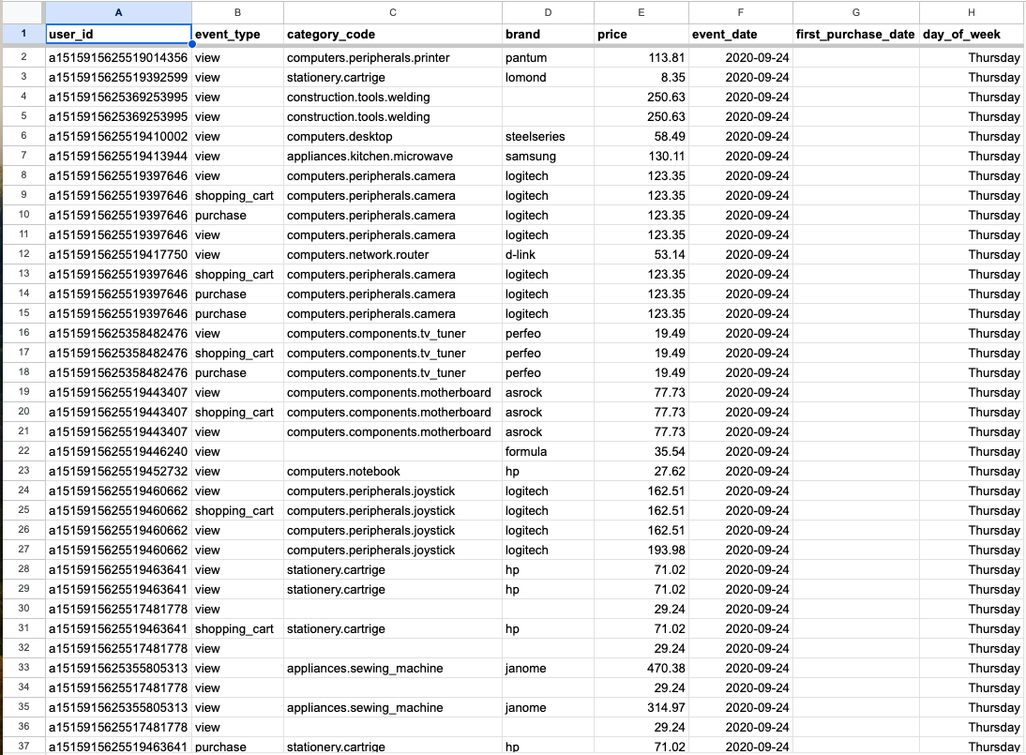
Raw User Activity

Slide 2
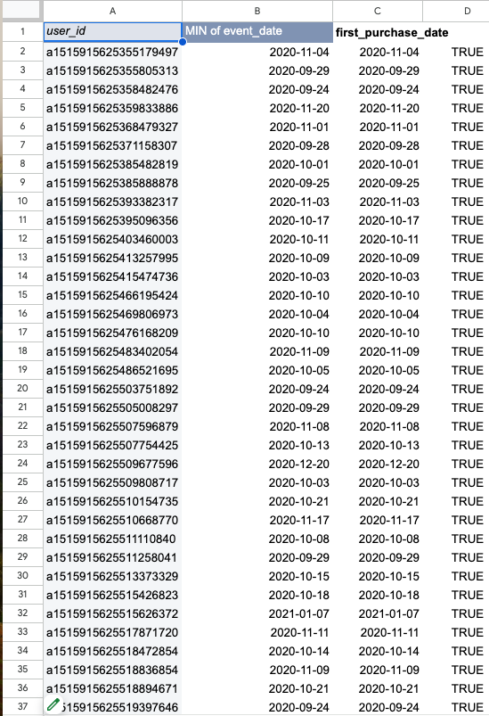
2. First Purchase data

Slide 3
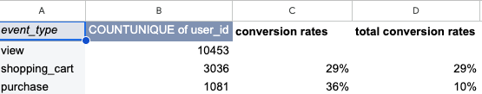
3. Conversion Funnel

Slide 4
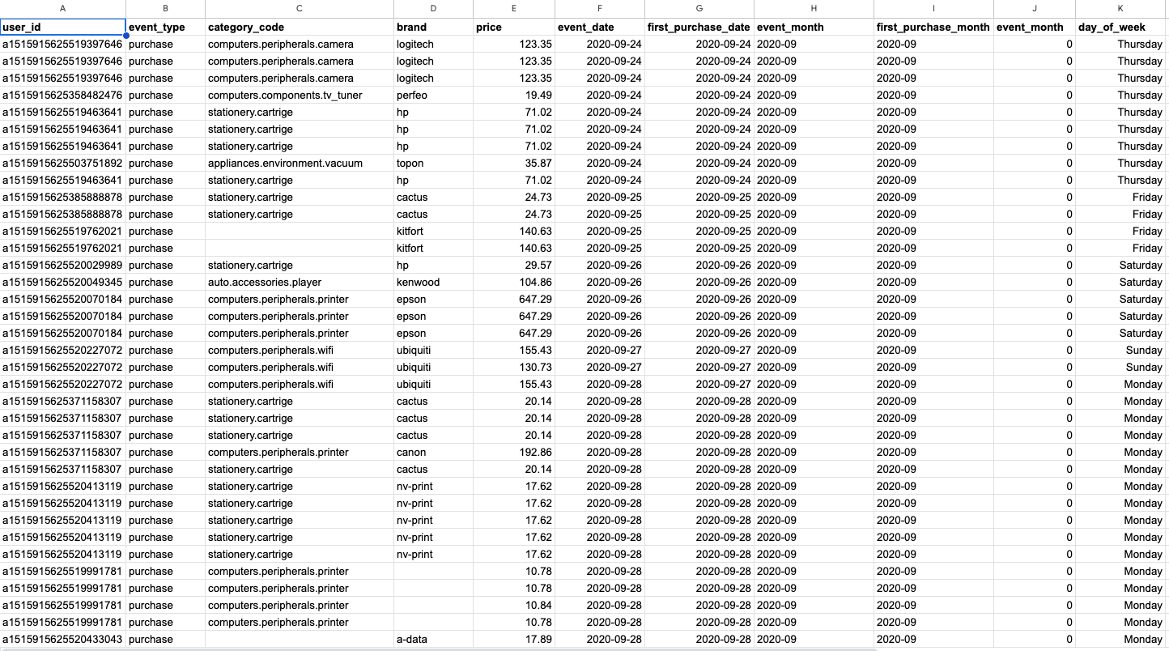
4. Purchase activity sample

Slide 5
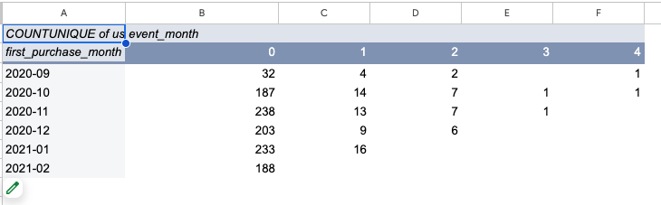
5. Cohort analysis

Slide 6
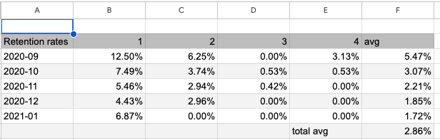
6. Retention Rates

Slide 7
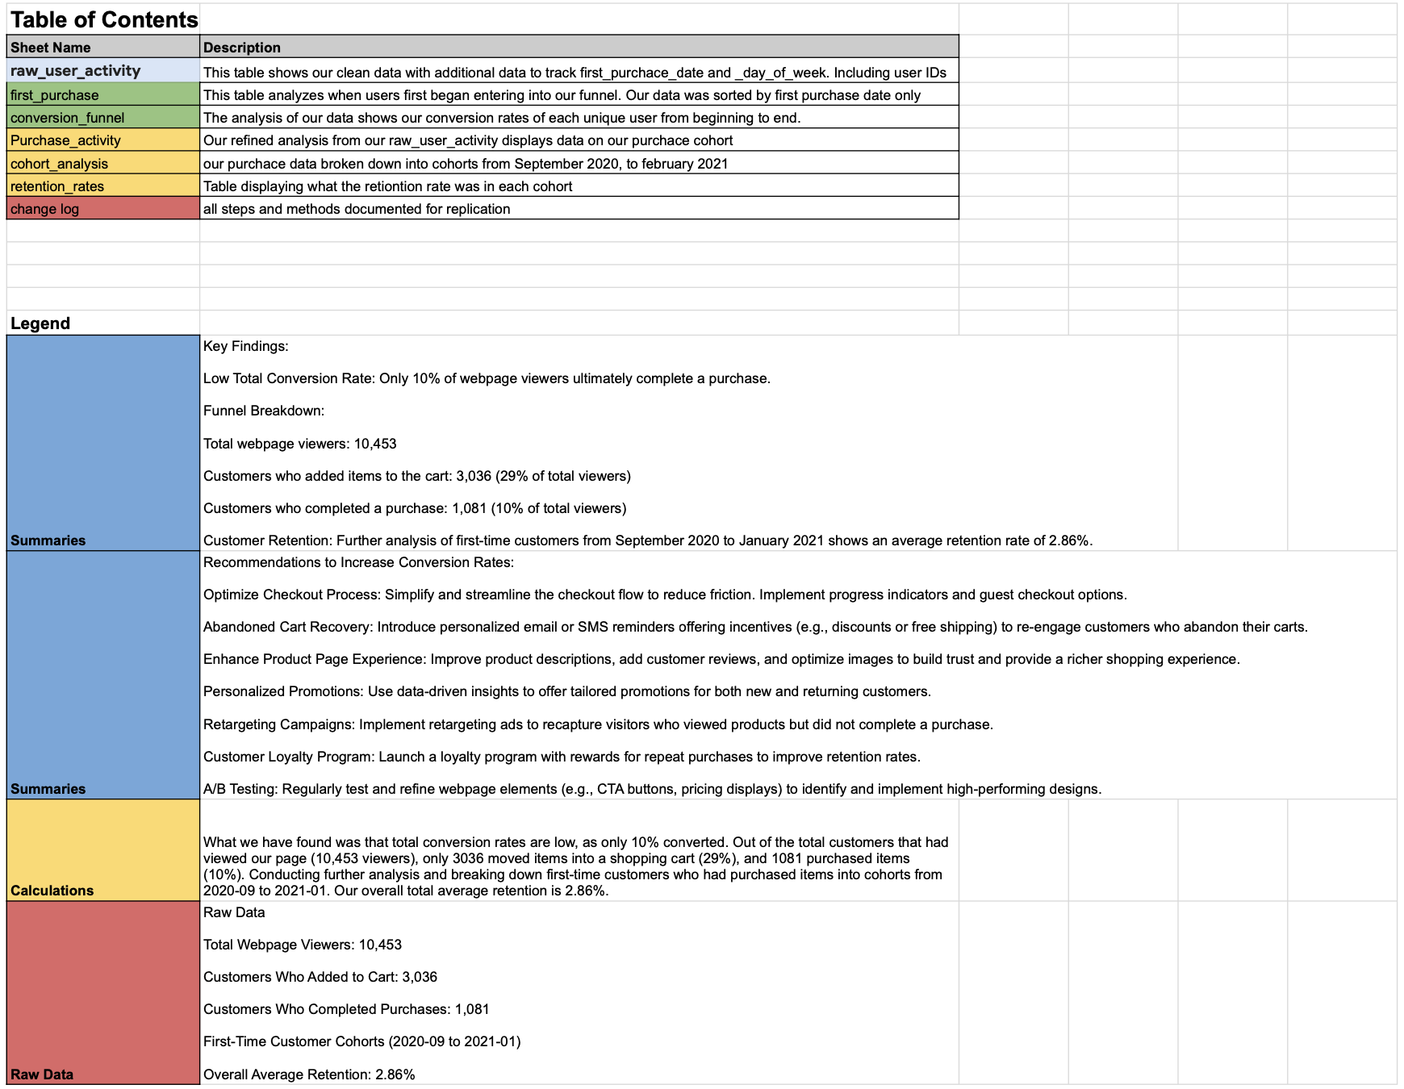
7. Table of Contents

Slide 8
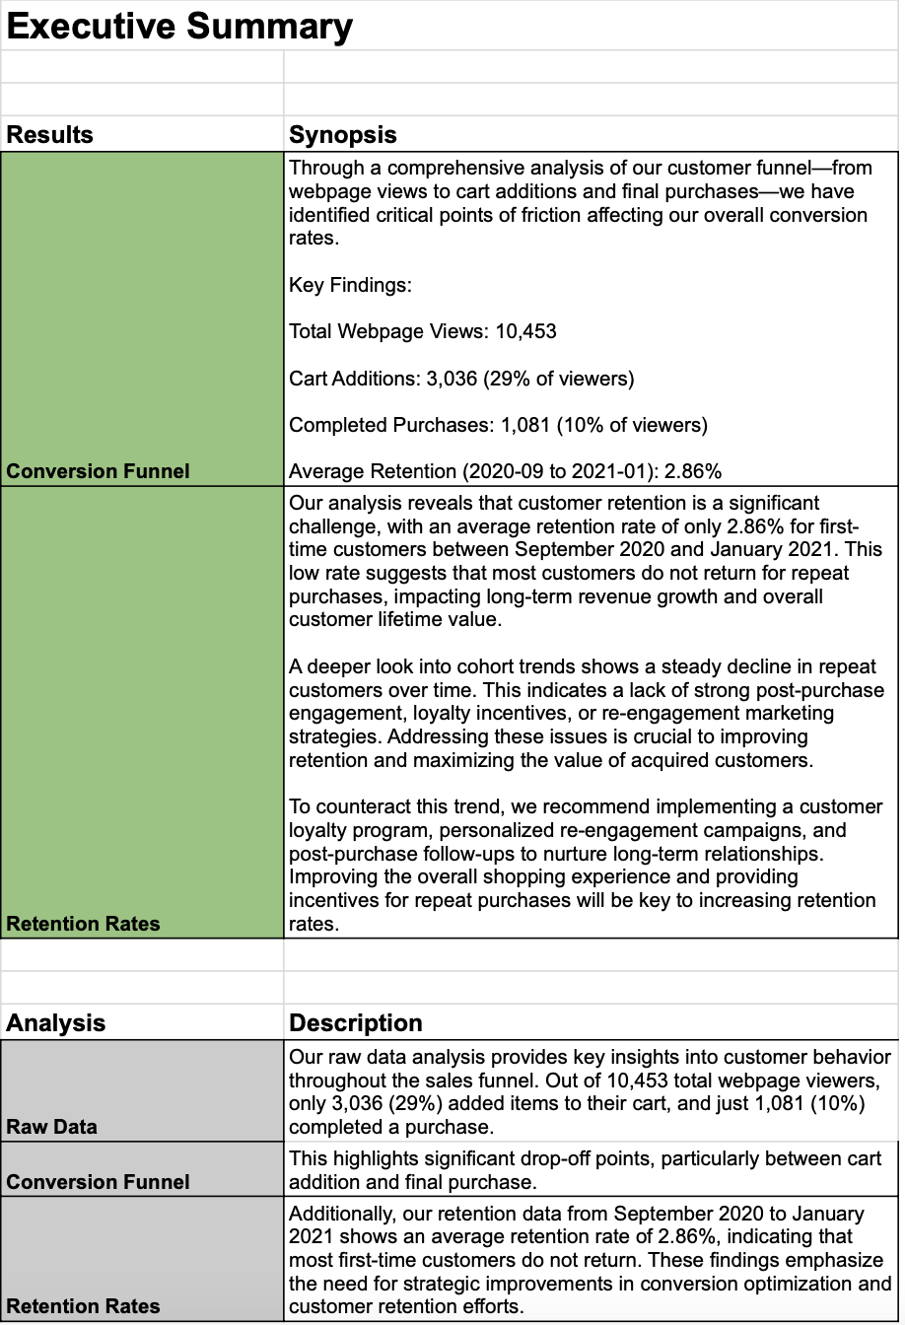
8. Executive Summary

Slide 9
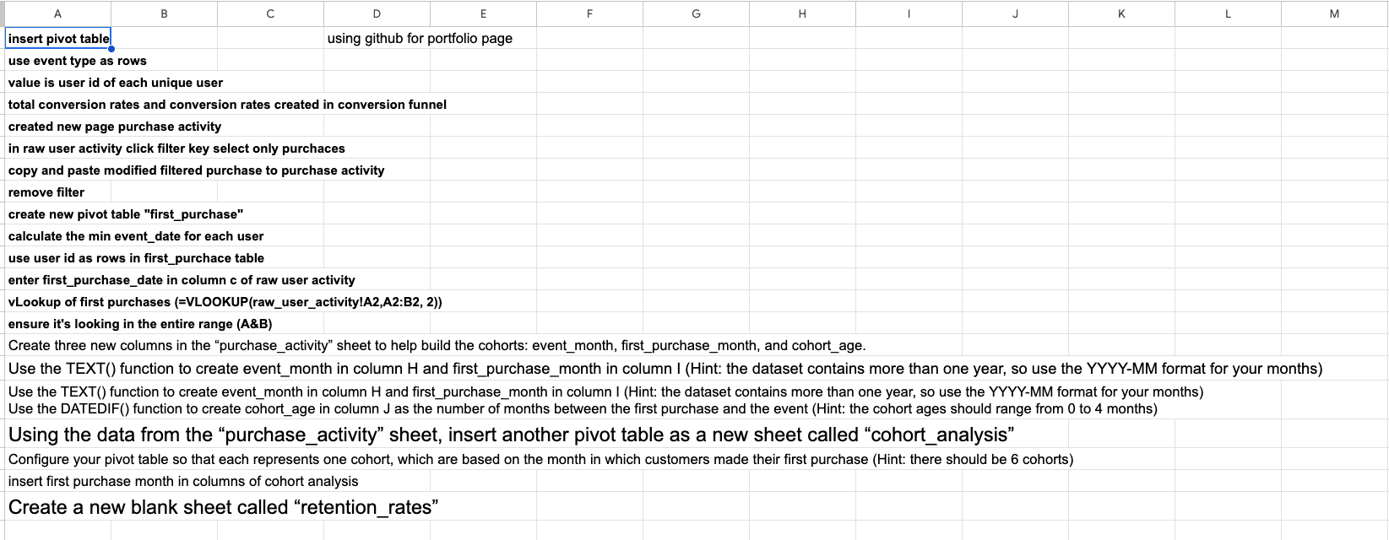
9. Change Log

